Slide 1

A Project Report on
Machine Learning Techniques for Accurate Flight Delay Forecasting
submitted in the partial fulfillment of the requirements for the award of the degree of
BACHELOR OF TECHNOLOGY
In
COMPUTER SCIENCE AND ENGINEERING
By
Devangam Harathi 212G1A0571
Shaik Sohail 222G5A0514
Madiga Shireesha 212G1A0594
K. Kiran Kumar 212G1A0591
V. Adi Keshava Reddy 212G1A05C1
V. Pradeep Kumar Naik 212G1A05B9
Under Supervision of
Dr. K. BHARGAVI _{M.Tech, Ph.D}
Associate Professor & HOD, Department of Computer Science and Engineering
ANANTHA LAKSHMI INSTITUTE OF TECHNOLOGY AND SCIENCES
Approved by AICTE, New Delhi & Affiliated to J.N.T.U. Ananthapuram, Accredited by
NAAC Near S.K. University, Itikalapalli(V), Anantapur (Dt) – 515 721.A.P.

Slide 2
CONTENTS
1. Abstract
2. Introduction
3. Existing Systems
3.1 Disadvantages
4. Proposed Systems
4.1 Objectives
4.2 Flight delay prediction model
4.3 Advantages
4.4 Software and Hardware Requirements
4.5 Modules
4.6 System Architecture
4.7 Proposed System Algorithms
5. System Design
5.1 DFD Diagram
5.2 Use Case Diagram
5.3 Sequence Diagram
6. Test cases
7. Results
8. Conclusion
9. References

Slide 3
1. ABSTRACT
Flight delays are a major challenge affecting passengers, airline operations, and regional economies.
This project introduces a Flight Delay Prediction System using Machine Learning techniques.
It analyzes historical flight data to train and evaluate models for predicting potential delays.
Algorithms :
Logistic Regression
Decision Tree
Random Forest
Gradient Boosting
Real-world datasets are utilized to ensure practical and relevant outcomes.
Project Goals:
Improve operational planning
Enhance passenger satisfaction
Minimize costs due to delays
.

Slide 4
2. INTRODUCTION
Flight delays impact efficiency and economics in aviation.
Commercial flights experience delays.
Project uses machine learning for accurate delay prediction.
Analyzes historical data including schedule, weather, and traffic.
Compares ML models:
Logistic Regression
Decision Tree
Random Forest
Gradient Boosting.
Goal: Build a scalable, real-time system.
Aims to improve planning, reduce delays, and enhance passenger experience.

Slide 5
3.EXISTING SYSTEMS
Uses basic statistical models like Linear Regression and Time-Series Analysis.
Involves manual delay management and basic scheduling tools.
Relies on limited data (e.g., scheduled times, historical delays).
Lacks predictive intelligence for proactive decisions.
3.1 Disadvantages of Existing Systems:
Limited Feature Scope: Ignores weather, traffic, and operational data.
Reactive in Nature: Deals with delays after they happen.
Low Accuracy: Struggles with complex relationships in flight data.
Outdated Methods: Depends on basic models like Decision Tree & Logistic Regression.

Slide 6
4. PROPOSED SYSTEMS
Utilizes advanced Machine Learning algorithms to forecast flight delays.
Trained on a comprehensive dataset from the U.S. Bureau of Transportation Statistics (2019).
Incorporates diverse features such as:
Weather conditions
Flight schedule data
Airport traffic
Airline-specific performance
Supports real-time prediction and proactive decision-making for airlines and passengers.
Enhances accuracy, scalability, and efficiency compared to traditional systems

Slide 7
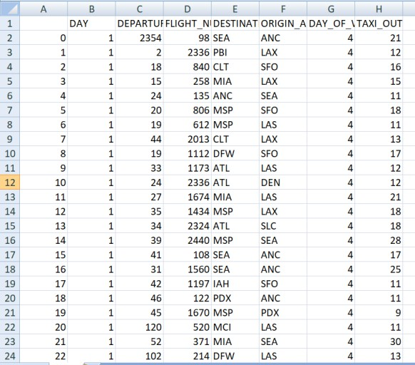
4.1 Objectives
To minimize flight delays and cancellations using predictive analytics.
To forecast delays based on historical and real-time flight attributes.
To assist airlines in optimizing flight schedules and resource management.
To provide passengers with timely and reliable delay predictions.
To develop a scalable and accurate prediction system using supervised machine learning models.
4.2 Flight delay prediction model:
Implements a structured approach using machine learning algorithms.
Flight Delay Data
The process begins by collecting real-world flight data from the official US BTS database, which includes details like schedule times, delays and more.

Slide 8
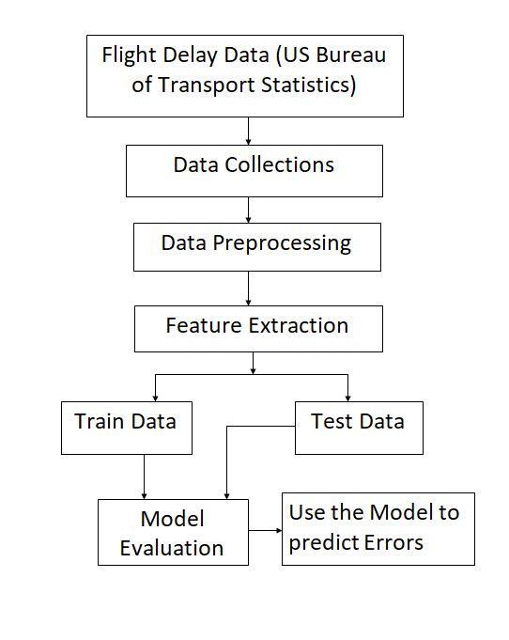
Data Collections
Gathering and aggregating relevant features from multiple sources such as flight history, weather reports, and airline schedules.
Data Preprocessing
Cleansing raw data by:
Removing missing values
Handling outliers and duplicates
Normalizing or standardizing feature
Feature Extraction
Selecting important inputs (features) that impact delay prediction:
Date, airline, airport, time of day
Taxi-out time, day of week, weather

Slide 9
Train Data / Test Data Split
Dataset is divided into:
Training Set – used to teach the model
Testing Set – used to evaluate model accuracy
Typically, 80% for training and 20% for testing.
Model Evaluation
The trained model is tested using the test data and evaluated using:
Confusion matrix: The confusion matrix is a table that summarizes the performance of a classification model by comparing actual and predicted values
 | Actually Positive(1) | Actually Negative(0)
Predicted Positive(1) | True Positives (TPs) | False Positives (FPs)
Predicted Negative(0) | False Negatives (FNs) | True Negatives (TNs

Slide 10




Accuracy metrics:
Accuracy: Represents the percentage of correctly predicted instance
Precision: Measures how many of the predicted positive cases were actually correct
Recall: Measures how many actual positive cases were correctly identified.
F1-Score: Balances precision and recall in a single metric

Slide 11
4.3 Advantages
Higher Accuracy
Real-Time Predictions
Scalable Solution
Better Passenger Experience
Automation & Efficiency
4.4 Software and Hardware Requirements
Hardware Requirements:
System : Intel Core i7.
Hard Disk : 1TB.
Monitor : 15’’ LED
Input Devices: Keyboard, Mouse
Ram : 16GB.
Software Requirements:
Operating system :Windows 10.
Coding Language :Python
Tool :Py Charm, Visual Studio Code
Database :SQLite3

Slide 12
4.5 Modules
User: Includes the entire ML pipeline: data collection, preprocessing, feature engineering, model training, evaluation, and real-time predictions.
Admin: Manages user access, oversees data storage and updates, initiates model retraining, and monitors system performance and API usage logs.
Enhancement: Integrates external factors like weather, holidays, and air traffic. Adds automation for retraining models with new flight and delay data.

Slide 13
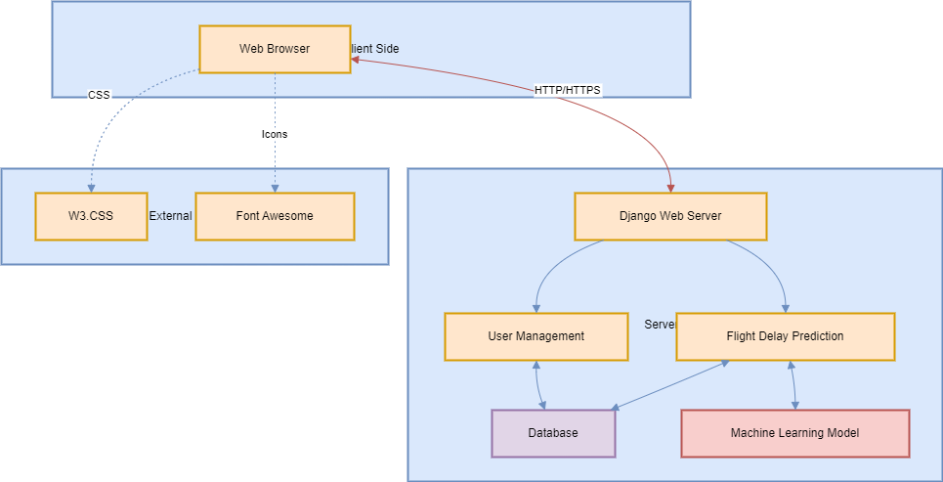
4. 6 System Architecture
Client (Web Browser): UI built with W3.CSS and Font Awesome, communicates via HTTP/HTTPS.
Server (Django): Handles login, registration, and prediction using:
User Management
Prediction Module
Database: Stores user info and flight data.
ML Model: Predicts delays using trained historical data.

Slide 14
4.7 Proposed System Algorithms
Algorithm Gradient Boosting
Input: Training Data, Labels, New Data
Output: Predicted Class
Step 1: Preprocess the data (clean and encode features)
Step 2: Start with a simple prediction (like the average of the labels).
Step 3: For each iteration:
Calculate the residuals (errors) from the current prediction.
Train a new tree on the residuals to improve the model.
Add the new tree’s predictions to the existing model with a small learning rate.
Step 4: For new data, use the final model’s prediction.
Step 5: Return the predicted class or value.
Algorithm Random Forest
Input: Training Data, Labels, New Data
Output: Predicted Class
Step 1: Preprocess the data (handle missing values and encode features)
Step 2: Build multiple decision trees:
For each tree, sample the data randomly (with replacement).
For each split, choose a random subset of features.
Step 3: For new data, get predictions from all trees.
Combine the predictions by majority voting (for classification) or averaging (for regression).
Step 4: Return the final predicted class.

Slide 15
Logistic Regression
Preprocess data: Clean and standardize features.
Train model: Learn weights (β) using training data.
Predict:
If P>0.5P > 0.5P>0.5, predict Class 1; else,
Class 0.
Output: Predicted class.
Understanding Logistic Regression Accuracy Issues:
Only models linear relationships.
Sensitive to outliers and feature scaling.
Struggles with non-linear or complex patterns.
Poor performance on imbalanced datasets.
Decision Tree
Preprocess data: Clean and encode categorical features.
Build tree:
Use Information Gain to choose best split.
Continue splitting until stopping criteria are met.
Predict: Traverse from root to leaf based on feature conditions.
Output: Predicted class from leaf node.
Accuracy Issues in Decision Tree Models
Prone to over fitting if the tree is too deep.
Can be misled by noisy or irrelevant features.
Performance drops on small or unbalanced datasets.
Not robust to data variation without pruning or ensemble methods.

Slide 16
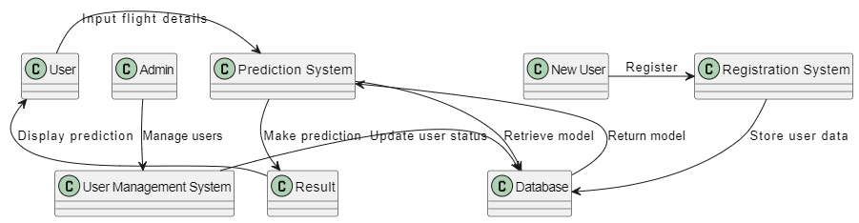
5. SYSTEM DESIGN
5.1 DFD Diagram
A DFD shows how data flows through the system:
User enters flight details and views predictions.
Admin manages users via the User Management System.
Prediction System processes inputs, interacts with the Result component and Database.
New Users register through the Registration System, which stores data in the Database.
The Database holds user info and ML models.

Slide 17
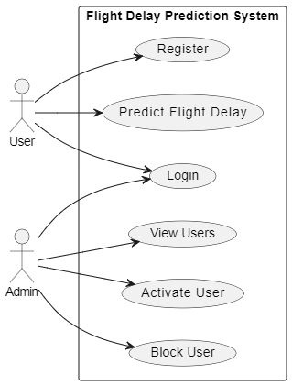
5.2 Use Case Diagram
A use case diagram is a visual representation that shows the interactions between users (actors) and a system to capture its functional requirements.
Actors:
User
Admin
User Use Cases:
Register: Sign up to create an account.
Login: Log in to access the system.
Predict Flight Delay: Enter flight details to get delay prediction.
Admin Use Cases:
Login: Access admin panel.
View Users: See all registered users.
Activate User: Approve user accounts.
Block User: Restrict access for specific users.

Slide 18
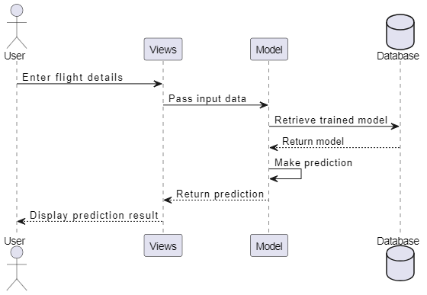
5.3 Sequence Diagram
A sequence diagram is a UML diagram that shows how objects interact in a system over time through the exchange of messages.
This diagram shows how the system predicts flight delays:
User enters flight details.
Views pass data to the Model.
Model retrieves the trained model from the Database.
Prediction is made and sent back to Views.
Views display the result to the User.

Slide 19
6. TEST CASES
Test Case No. | Test Scenario | Test Steps | Expected Outcome
1 | Valid Input Data | 1. Input valid data for all fields (e.g., FL_DATE, TAIL_NUM, CRS_DEP_TIME). | Form should submit successfully and display prediction result.
 |  | 2. Submit the form.
2 | Invalid Flight Date | 1. Input an invalid or future date for FL_DATE. | The form should reject submission and show an error message like "Invalid date."
 |  | 2. Submit the form.
3 | Missing Required Fields | 1. Leave some required fields (e.g., OP_UNIQUE_CARRIER) blank. | Error messages should indicate missing fields, and no prediction is made.
 |  | 2. Submit the form.
4 | Predicting for Cancelled Flight | 1. Set CANCELLED to 1. | The system should display a message like "Flight is canceled," and no prediction is made.
 |  | 2. Fill other fields with valid data.
 |  | 3. Submit the form.
5 | Invalid Airport ID | 1. Input invalid data for ORIGIN_AIRPORT_ID or DEST_AIRPORT_ID. | Error message should display "Invalid Airport ID."
 |  | 2. Submit the form.
6 | Valid Flight Number Format | 1. Input a valid numeric flight number in OP_CARRIER_FL_NUM. | Form should submit successfully, and a prediction should be displayed.
 |  | 2. Submit the form.

Slide 20
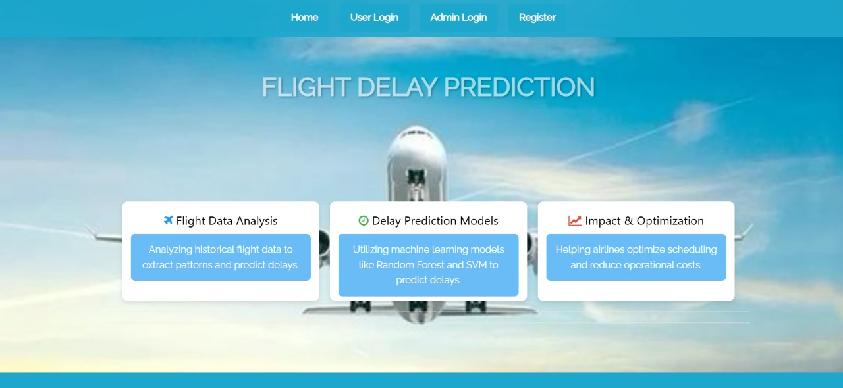
7. RESULTS:
Fig 7.1 Home Page

Slide 21
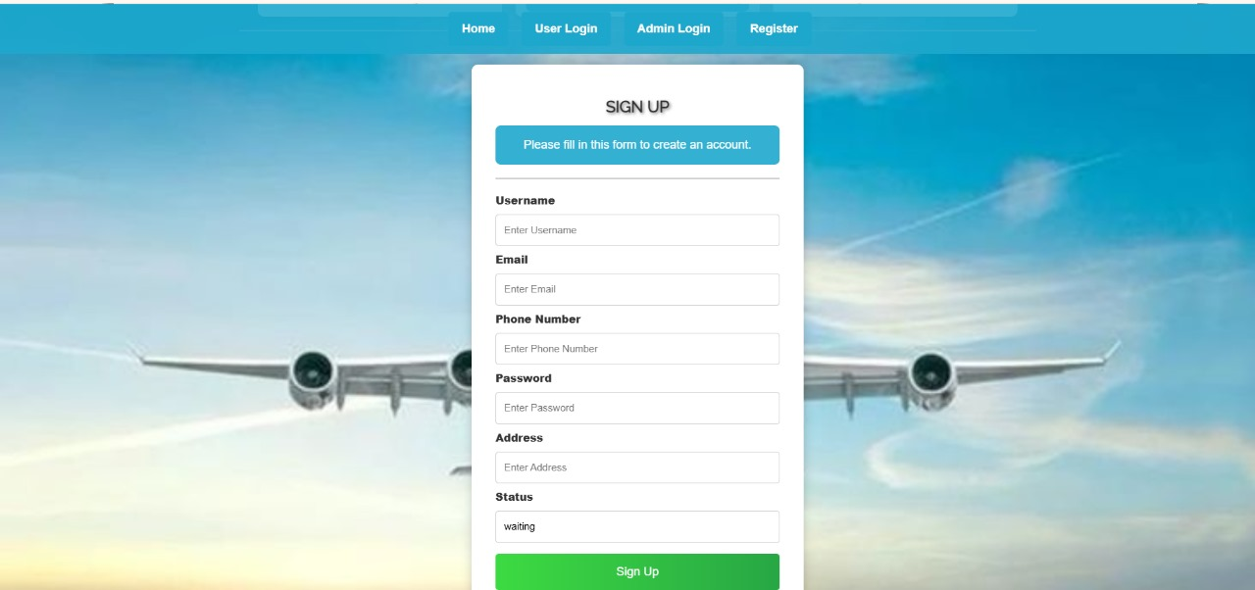
Fig 7.2 User Registration Page

Slide 22
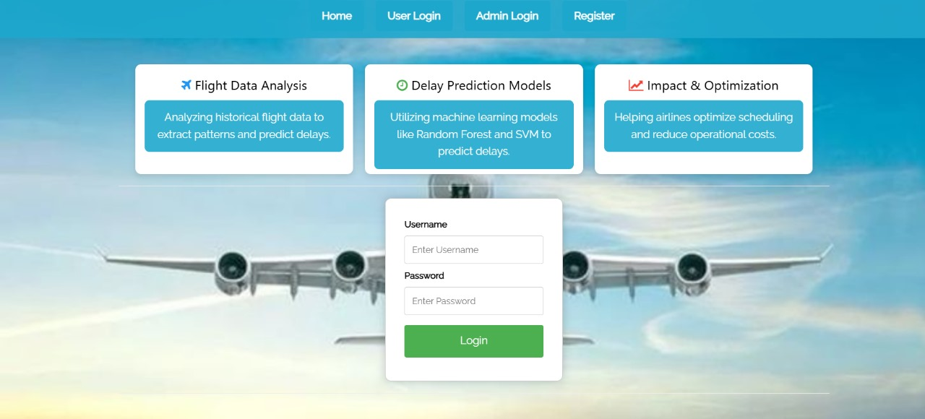
Fig 7.3 User Login Page

Slide 23
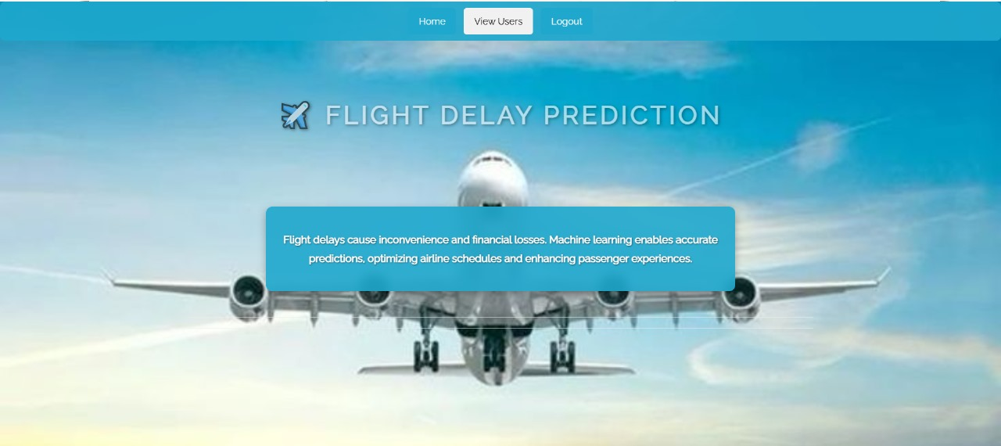
Fig 7.4 Admin Home Page

Slide 24

Fig 7.5 Fig. User Home Page

Slide 25

Fig 7.6 Training Result Page

Slide 26
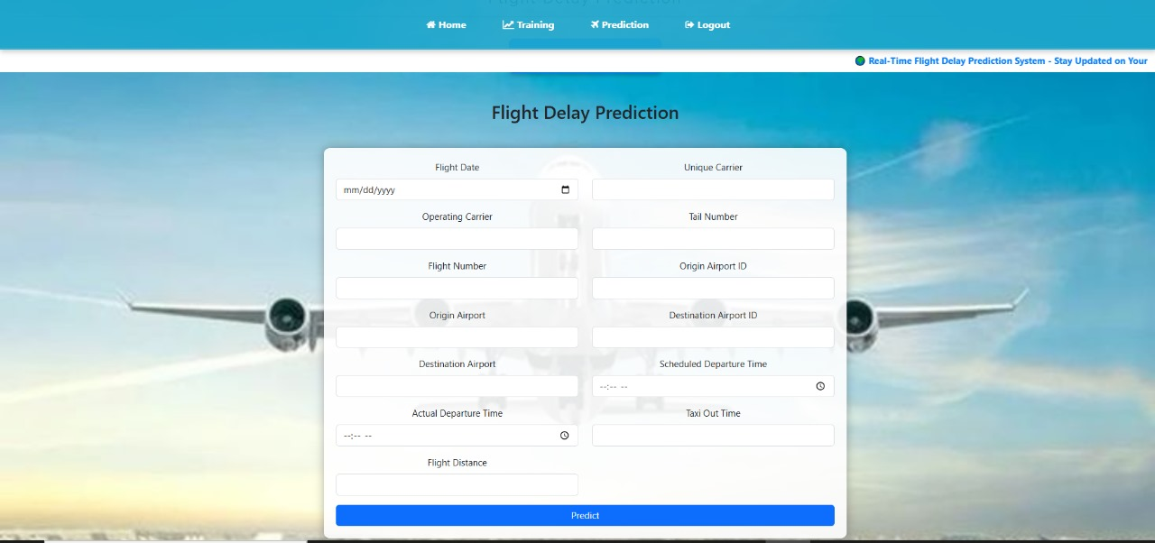
Fig 7.7 Flight Delay Prediction Page

Slide 27
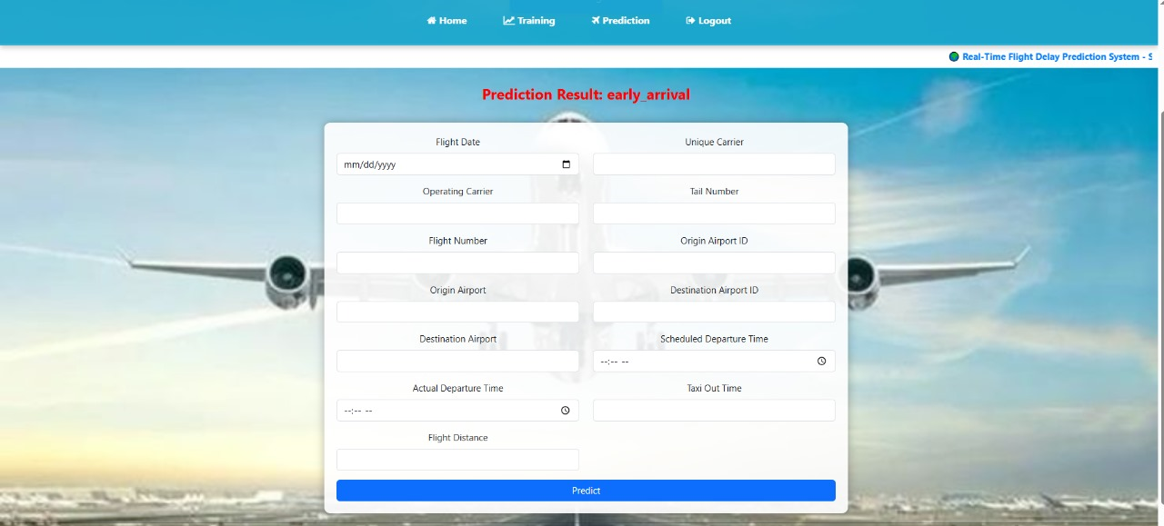
Fig 7.8 Prediction Result

Slide 28
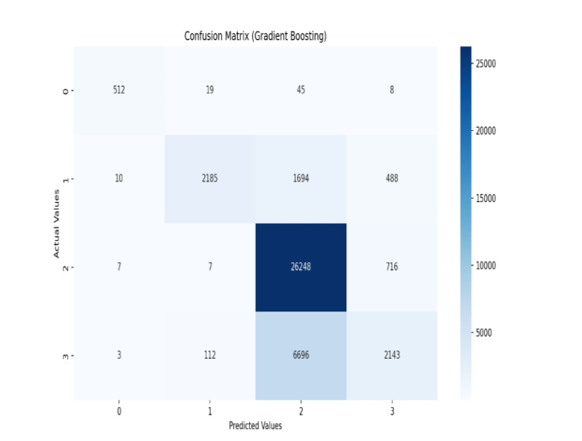
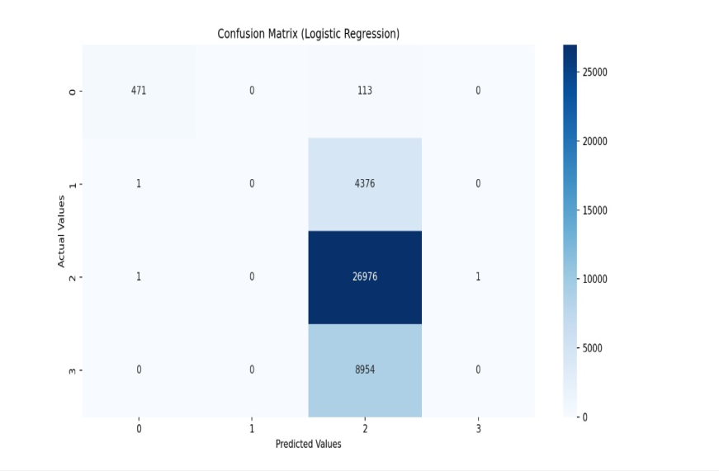
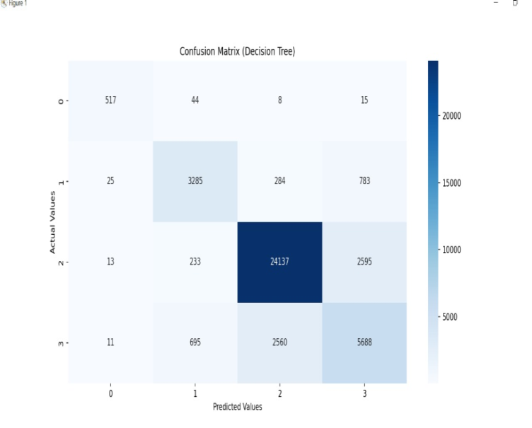
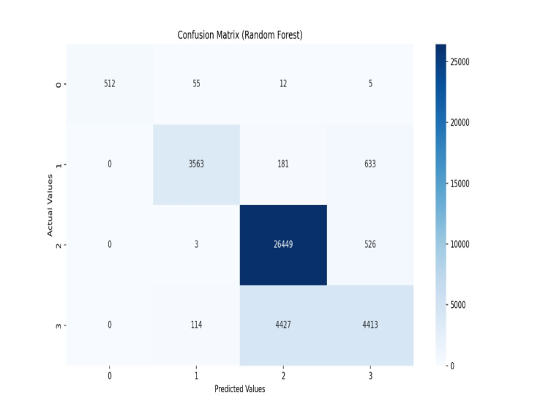
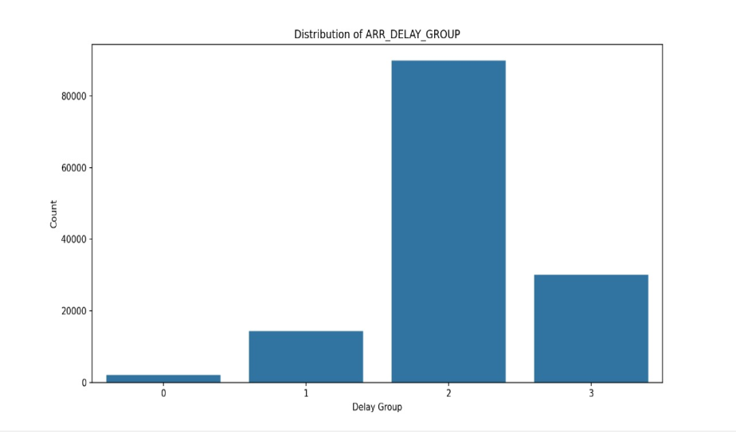
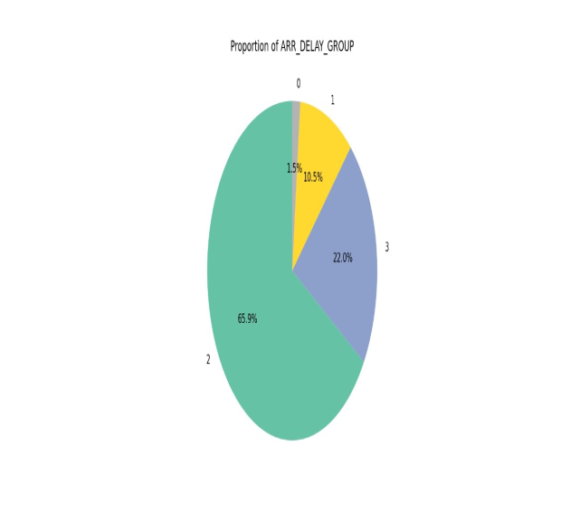
Graphs

Slide 29
8.CONCLUSION
Developed a machine learning-based system to predict flight delays accurately.
Implemented and evaluated multiple models to improve prediction performance.
Built a user-friendly interface using Django for real-time predictions.
Helps airlines and passengers plan better and reduce uncertainty.
Future work includes adding more features and optimizing model accuracy further.

Slide 30
9. REFERENCES
[1] Borse, Y., Jain, D., Sharma, S., Vora, V., and Zaveri, A. (2020) Flight Delay Prediction System. International Journal Of Engineering Research & Technology (IJERT) Volume 09, Issue 03 (March 2020).
[2] Bureau of Transportation Statistics. Available online: https://www.bts.gov/ (accessed on 26 March 2020).
[3] Akpinar, M.T. and Karabacak, M.E. (2017). Data mining applications in civil aviation sector: State-of-art review. In CEUR Workshop Proc (Vol. 1852, pp. 18-25).
[4] Nazeri, Z. and Zhang, J. (2017). Mining Aviation Data to Understand Impacts of Severe Weather. In Proceedings of the International Conference on Information Technology: Coding and Computing (ITCC.02) pp. 518-523.
[5] Ha. ,. J. N. a. H. P. S. Man. (2015) "Analysis of Air-Moving on Schedule Big Data based on Crisp Dm Methodology," ARPN Journal of Engineering and Applied Sciences, pp. 2088-2091.

Slide 31
THANK YOU

